Slide 1

Mobile price classification
Group 5
Iliagouev; Kiri; Plachetzky ; Vural ; Zelenay

Slide 2
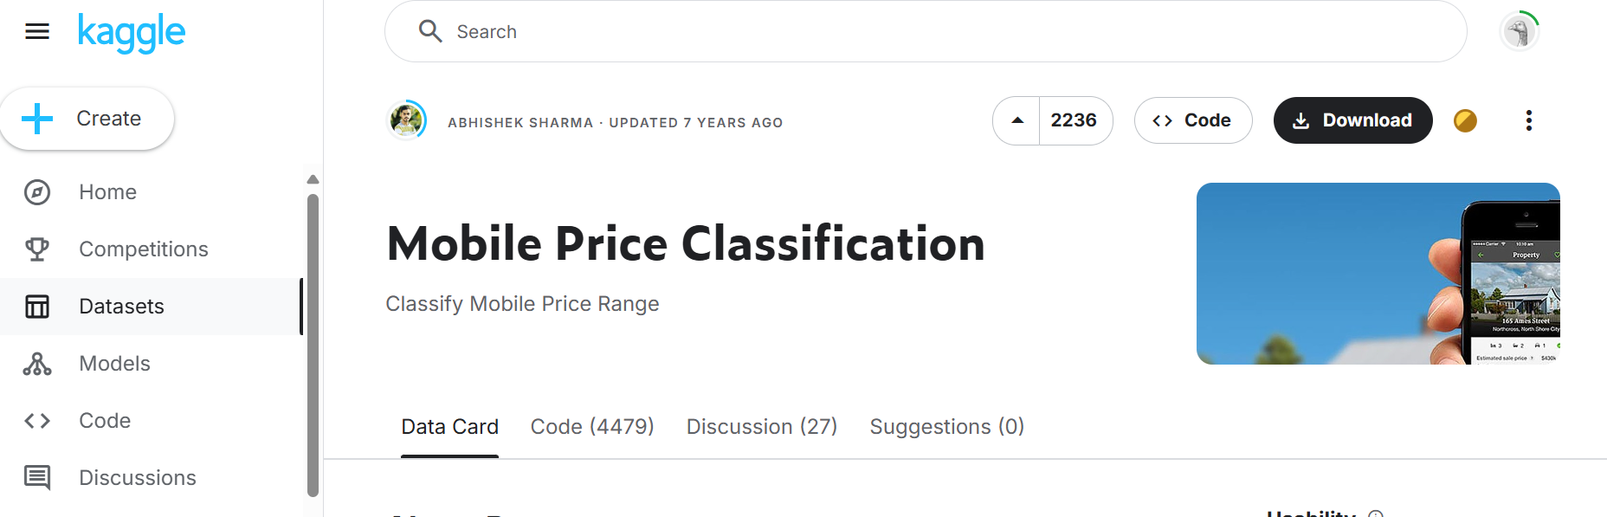
Our Dataset
Mobile Price Classification

Slide 3
Problem & Goal
Problem
Classification problem – Predicting price category based on technical specifications
Goal
Assist manufacturers in identifying the appropriate price range for their mobile phones
Compare different models

Slide 4
Hypothesis & Benefits
Hypothesis
There is a notable correlation between the features of a mobile phone and its classification into different price ranges
Specifically, as the features (such as RAM, CPU, or resolution) improve or increase, the corresponding price range is likely to expand as well
______________________________________________________
Benefits
Optimize mobile pricing to position products effectively
Understand customer expectations on features, performance, and price
Maximize profits by balancing affordability and business gains

Slide 5
Preliminary schedule
Identify the relevant features
Decide on the evaluation metrics to assess model’s performance
Preprocess data
Choose appropriate algorithm for classification
Tune the hyperparameters (use correct k)
Make recommendations based on the result

Slide 6
Work distribution
Algorithm selection and model development: 3-4 weeks
Model tuning and evaluation: 2-3 weeks
Documentation and reporting: 2 weeks

Slide 7
Thank you for your attention

